Slide 1
Sister Sister events
Storyboard

Slide 2
Statement of Purpose
The purpose of this site is to excite and build awareness of a launching event company, Sister Sister events. A family run company established to coordinate and decorate for family events.

Slide 3



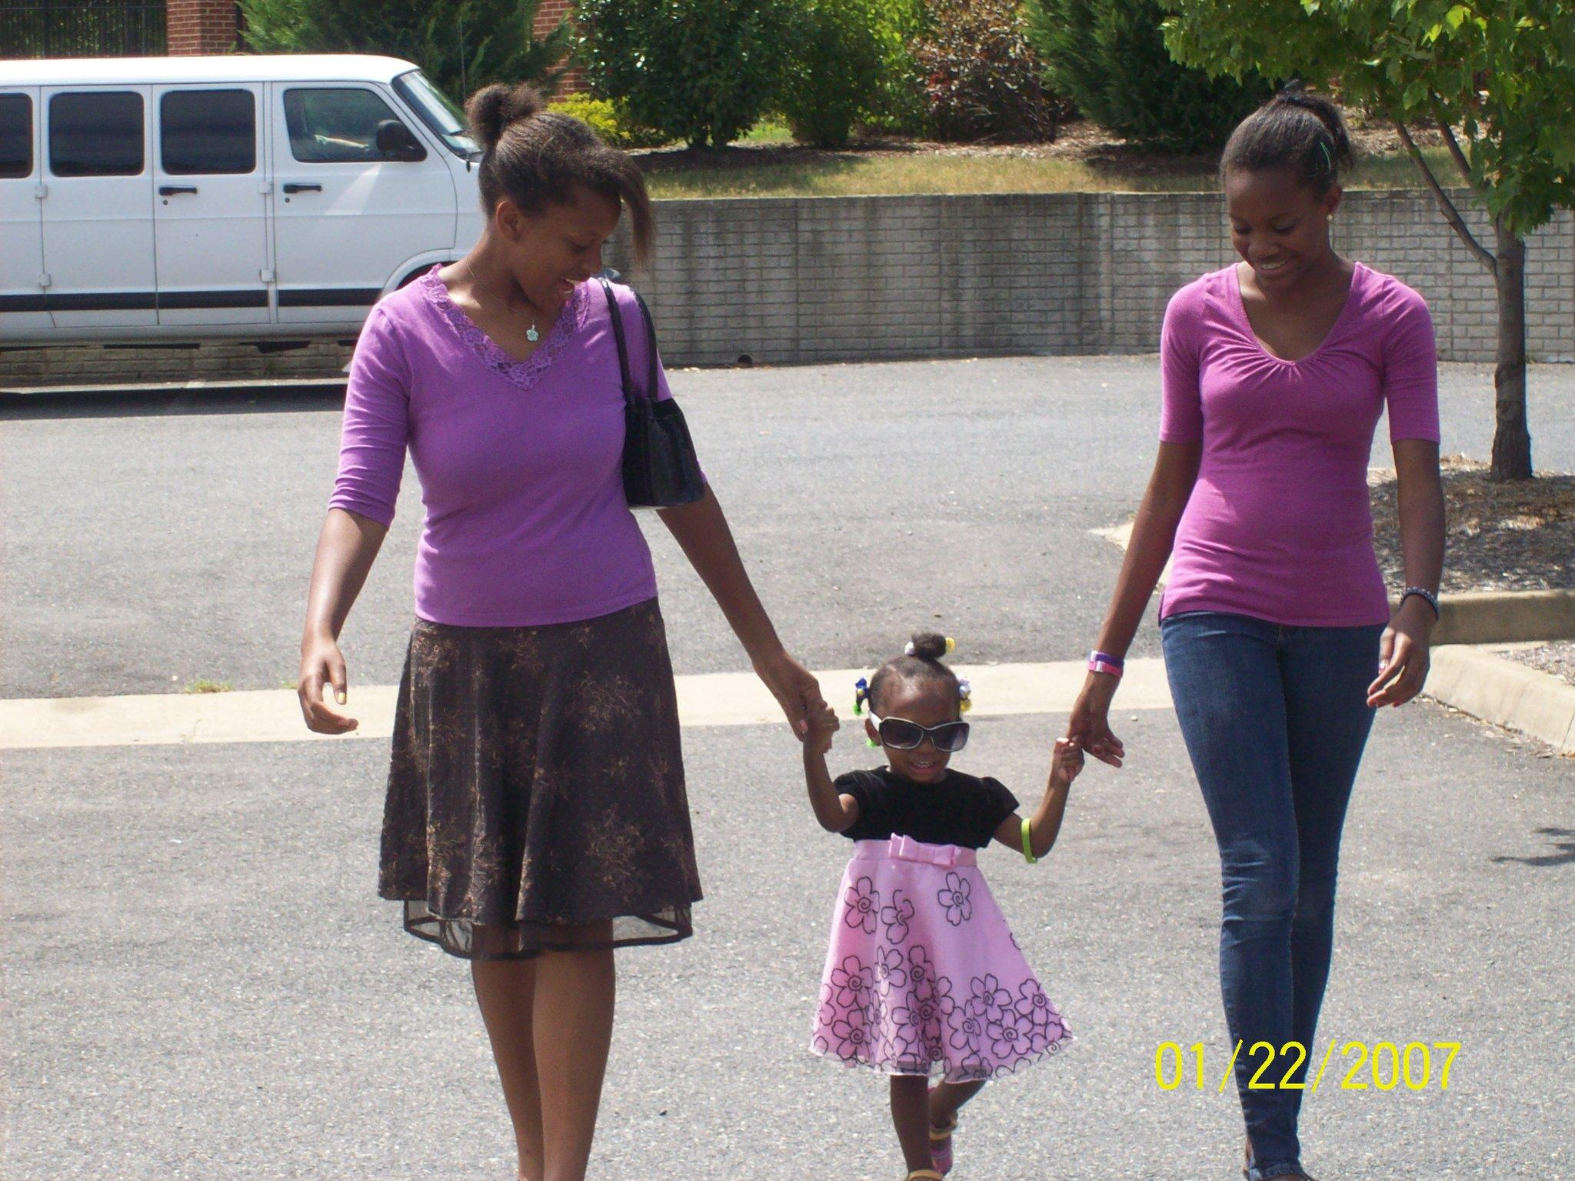


Homepage
Navigation list
Icons used to denote email, phone and donation options
Icon navigation- Happenings, Services, Social media
Notes:
Icon Navigation:The happenings are the current events that lead to both a picture library of flyers and the details linked to documents within a CSS sheet. Services leads to reserve your consultation to the footer where there is an input option for feedback.

Slide 4
Happenings page
Baby Showers
Family Reunions
Family Get togethers
Notes:
Link to past events- Image for each event
Instead of the scroll down option having all options the events scroll will have a happenings option
To this page which can direct you to all past events- a feature event can be added to the events scroll Navigation option

Slide 5



Reserve your event
Notes:
Icon Navigation: Costs, Service packages, Social Media, Contact information
These icons scroll the guest down the page to the information of how to- no need for multiple pages
The reserve your consultation Navigation option will also direct the guest to this page and to the right section

Slide 6
Who are we
Information about the organization- Mission & Vision
Testimonials
Facts

Slide 7
What we do
Coordinate Event
Decorate for the Event
Notes:
Program and services Icons lead to further detail within the page about each program and service

Slide 8
Team members
Coordinator
Decorator
List of members with pictures if avail.
Notes:
Pictures and Bios of current team members
Link to ‘Reserve your consultation’

